Slide 1
Impact of Science in daily life
Presented By
Anupam

Slide 2
What is Science?
Science is the study of and knowledge about the physical world and natural law. Biology, Physics and chemistry are all sciences. Science is curiosity thoughtful action about the world and how it behaves.

Slide 3
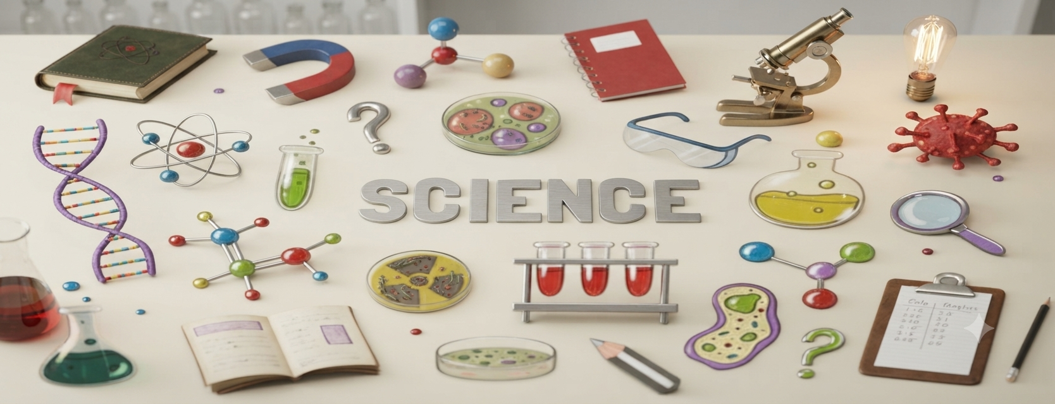
Science

Slide 4

Science is an amazing blessing to humans. It makes our daily life easier and more comfortable. We cannot think about our life without science. Science has changed our life.

Slide 5
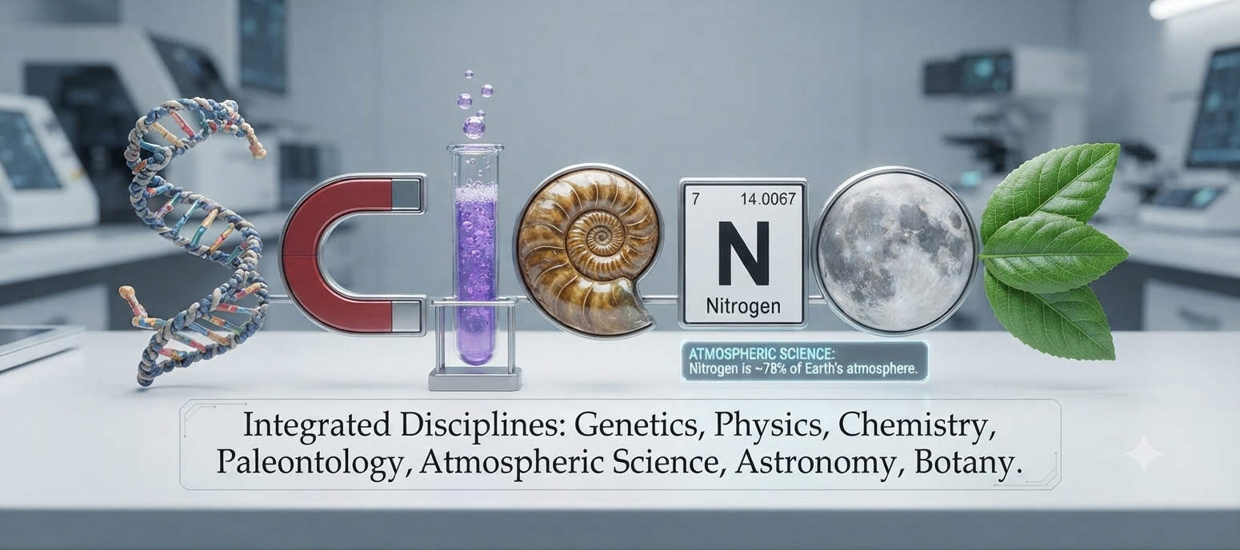
Science is everywhere

Slide 6
Electricity- Example of Science in Daily Life
It gives us cool air and entairtains us through cinema, TV and radio, besides lighting our houses. Modern life is impossible without electricity.

Slide 7
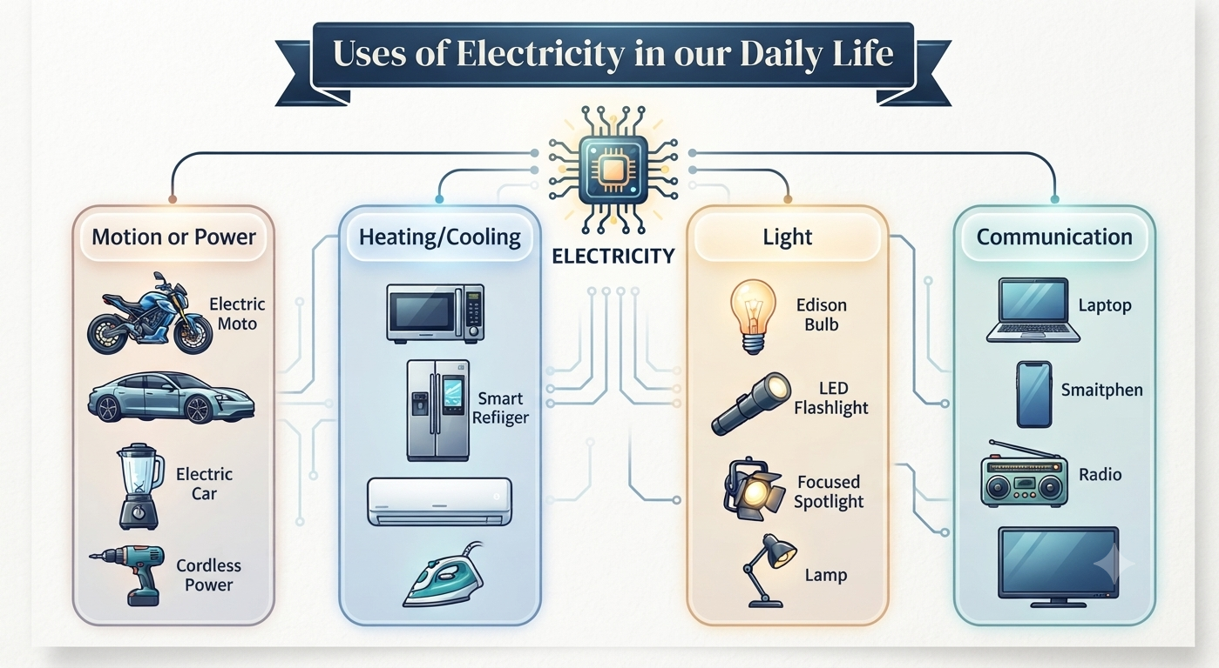

Slide 8

Science has developed, invented and discovered different medium of communication that is very useful us in our daily life.

Slide 9

Science has developed different types of machine and tools that is very useful in our daily life.

Slide 10

Computers have each and everything easy like calculations and other stuff beyond our imagination.

Slide 11

Science has invented number of wounderful drugs that are used for pain killing and these drugs are very useful in everyday life

Slide 12
Thank You

